Slide 1
DevOps
Module 7, Lesson 4:
Creating a Web Server in Azure with Chef

Slide 2
Objectives
By the end of this lesson you should be able to:
Understand the purpose and functionality of a web server
Launch a virtual CentOS and Windows instance
Install the Chef Development Kit (ChefDK) onto the instances
Write a Chef recipe to Install, Start and Configure Apache (for Linux) and IIS (for Windows) web servers
Use the chef-client command in local-mode to converge the node
Visually verify that a web server is running on each instance

Slide 3
Purpose of a Web Server
Users can make http requests over a network, web servers respond to those requests
Web servers send files back to users. Those files are interpreted by and displayed on the user’s browser
Web servers allow users to interact with dynamic database-driven applications

Slide 4
Practical Example
The steps required to launch and install a web server are:
Launch virtual CentOS and Windows instances
Install Chef tools on each platform
Write a Chef script to install a web server on each platform
Converge each node
Verify a web server is running on each node
Notes:
Notes:
Convergance is the process of having an application on the node (chef-client) read the recipe, and do whatever is needed to make sure the instance adheres to the policies written in the recipe. For example: - If the recipe (policy) states that Apache should be installed, but Apache is currently not installed, then chef-client invokes the instances package manager to install Apache. - If the Apache is already installed, chef-client tests and sees this, and does nothing since the instance is already in policy
Verifying the web server in this module is done by ‘smoke test’ where we simply look to see if it is running. No actual tests are run in the lesson. In later lessons, we’ll implement unit and integration testing, using the instance and web servers we created in this lesson.

Slide 5
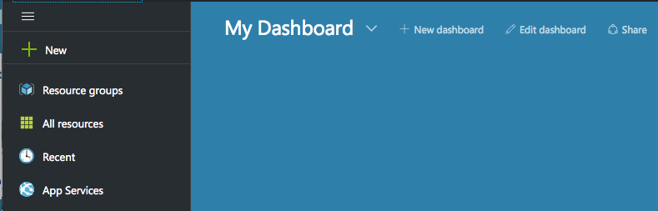
Launch An Instance
Launch a virtual CentOS 7.1 instances in the Azure portal
Notes:
Notes:
The students will launch a new instance in the Azure portal

Slide 6
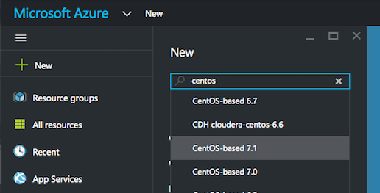
Choose An OS
Choose the CentOS-based 7.1 image
Notes:
Notes:
We will start with the Centos 7.1 instance

Slide 7
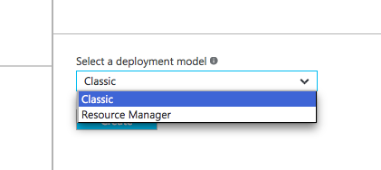
Use The Classic Deployment Model
Choose the Classic deployment model
Notes:
Notes:
We are using Classic deployment mode.
Resource Manager is a more advanced deployment mode.

Slide 8
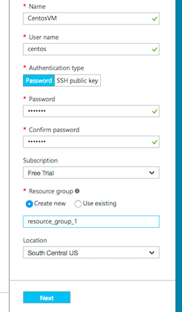
Instance Specs
Complete the form:
Use any VM Name
Use any User name
Create a Password
Create a new Resource Group (with any name)
Choose default Location
Click ‘Next’
Notes:
Notes:
Here we give the instance it’s name, user and password, as well as choosing the Resource Group and in which Azure datacenter (location) to launch the instance.
A resource group is a container in which every resource associated with the instance resides

Slide 9
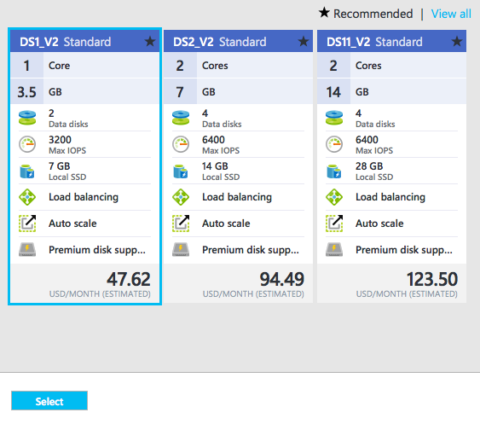
Machine Size
Choose Machine Size:
Choose the smallest machine size offered
Click ‘Select’
Notes:
Notes:
Here we choose the size of the machine. The bigger the machine the more expensive it is to run. For our purposes, choose the least expensive machine size.

Slide 10
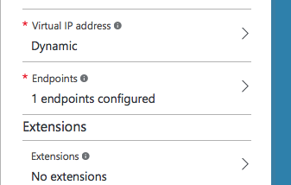
Configure Endpoints
Configure the Endpoint
Click on ‘Endpoints’
Notes:
Notes:
Endpoints open access permissions to specific ports.
Without this step, even if the node converges correctly, you won’t be able to access it via a web page

Slide 11
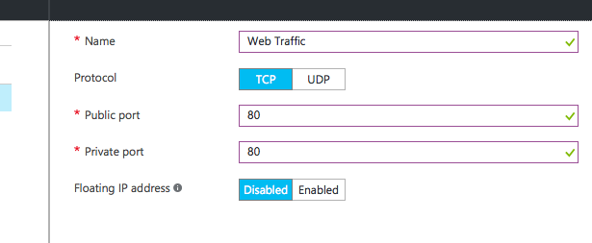
Configure Endpoints
Add an endpoint
Complete the form
Use TCP as the Protocol
Give the Endpoint a name
Use port 80 as the Public and Private port
Click OK to clear the screens and launch the instance
Notes:
Notes:
Here we open access to port 80.
Without this access, even if the node converges correctly, you won’t be able to see the web page that you created.

Slide 12
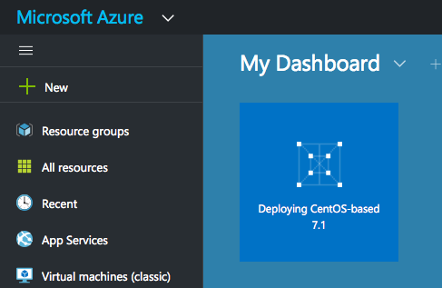
Launch The Instance
Your instance will launch

Slide 13
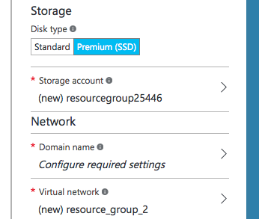
Windows Difference – Domain Name
Configure the Domain Name
Windows requires an additional step – to configure the domain name
Click on ‘Domain Name’ under the Network heading
Notes:
Notes:
With Windows there is an additional step of creating a unique domain name for the instance

Slide 14
Installing ChefDK on Linux
ChefDK is the Chef Development Kit – the primary development environment for Chef
The ChefDK will enable the use of Chef without using a Chef Server
The ChefDK includes other development tools such as Berkshelf, Foodcritic, Test Kitchen and chef-client
Notes:
Notes:
The ChefDK is a development environment that contains the tools needed for most Chef development

Slide 15
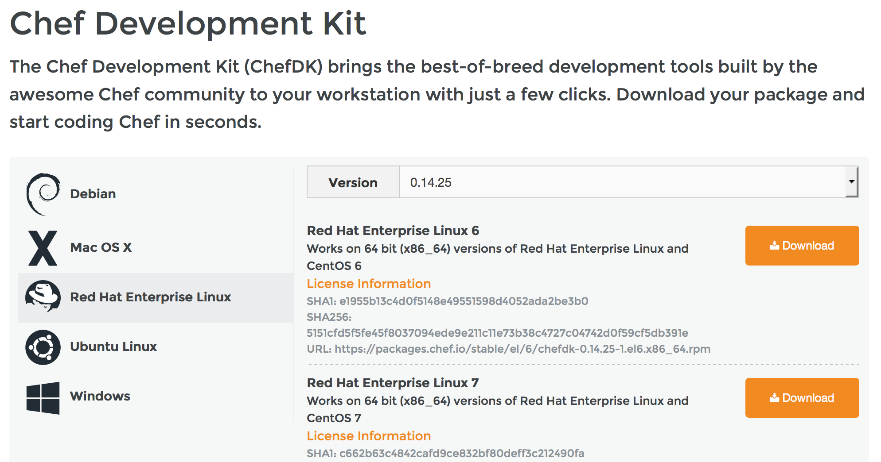
Installing ChefDK on Linux
There are multiple ChefDK versions available
Notes:
Notes:
There are ChefDK versions available for most major platforms
You can also install previous versions
Due to Javascript interpretation issues, Internet Explorer may not render this page correctly.

Slide 16
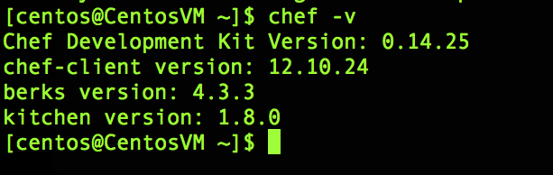
ChefDK Verification
Verify the ChefDK installation
$chef -v will verify the ChefDK is installed
Reporting of the version numbers indicates a successful installation
Notes:
Notes:
Several useful development tools are included in the ChefDK. Their version numbers are listed here.

Slide 17
Write A Chef Recipe
First, create a cookbooks directory
This is where cookbooks will be stored
Notes:
Notes:
The chef-client application requires a cookbooks directory. It will look in this directory for its cookbooks and recipes.

Slide 18
Write A Chef Recipe
Second, create a new cookbook
Use the chef generate command to create the apache cookbook $chef generate cookbook cookbooks/apache
Notes:
Notes:
The ‘chef generate cookbook’ command creates cookbooks. Cookbooks can also be created manually (by creating the directories) or with the ‘knife cookbook create <cookbook_name>’ command as well. ‘chef generate cookbook’ creates a lighter-weight cook structure than ‘knife cookbook create’
The command is ‘chef generate’
The item to generate is ‘cookbook’
The path and name of the cookbook in this case is ‘cookbooks/apache’. This is assuming the command is run from the home directory and has access to the cookbooks directory.
Other examples of chef generate; chef generate template cookbooks/apache/templates/default/my_template.rb This creates a new templates/default directory in the apache cookbook, and creates a template file named ‘my_template.rb’

Slide 19
Write A Chef Recipe
Install Apache
In the new file, add the resources to install, configure and start Apache
Start with the ‘package’ resource to install Apache
The package name is ‘httpd’ package ‘httpd’ do action :install end
Notes:
Notes:
The ‘package’ resource invokes ‘yum’ if being run on a CentOS machine, and invokes ‘apt-get’ on an Ubuntu machine.
‘httpd’ is the name of Apache on CentOS. If this was being run on an Ubuntu machine where the name of the Apache package is ‘apache2’, the line would read package ‘apache2’ do
The line ‘action :install’ is the default action. This line could be left out for brevity since the default action will be taken if no action is specified, and the default action for the package resource is ‘install’.

Slide 20
Write A Chef Recipe
Write a web page for Apache to serve
Next, use the ‘file’ resource to create a web page
The file name is ‘/var/www/html/index.html’ file ‘/var/www/html/index.html’ do content ‘<h1>Hello World</h1>’ action :create end
Notes:
Notes:
You could also include file permissions here with ‘mode’ for Linux and ‘rights’ for Windows. Linux mode example to set permissions to 644: file ‘/var/www/html/index.html’ do content ‘<h1>Hello World</h1>’ action :create mode “0644” end
More advanced recipes might use the ‘cookbook_file’ or ‘template’ resources, rather then the more simplistic ‘file’ resource. ‘file’ is a good resource for learning Chef, but not necessarily for using Chef.

Slide 21
Write A Chef Recipe
Start the Apache web service
Use the ‘service’ resource to start Apache (httpd)
Brackets denote that two separate actions are being implemented
The two actions ‘enable’ the service to start upon reboot as well ‘start’ the service now service ‘httpd’ do action [:enable, :start] end
Notes:
Notes:
We need both actions if we want the service to automatically restart should the node be rebooted for any reason.
This invokes the ‘service’ command on the node to perform the requested task
If the node is already configured to restart the service, and if the service is already running, then this resource will be skipped. This is the nature of ‘idempotence’.

Slide 22
apache.rb Completed File (Linux)
package ‘httpd’ do
action :install
end
file ‘/var/www/html/index.html’ do
content ‘<h1>Hello World</h1>’
action :create
end
service ‘httpd’ do
action [:enable, :start]
end
Notes:
Notes:
Entire recipe.

Slide 23
Converge The Node
Instruct the node to execute the Chef recipe
Converging the node will instruct the node to run the commands necessary to adhere to the policy written in the recipe
$chef-client -z -o recipe[apache::install-apache]
Uses the chef-client application in local mode, without a Chef server
chef-client only takes the actions needed – this is called ‘idempotence’
Notes:
Notes:
The ‘z’ option runs chef-client in local mode. Without this flag chef-client would try to connect to a chef-server.
The ‘o’ option creates the run-list, the ordered list of recipes to run.
recipe[apache::install-apache] is read as follows:
recipe: this is a recipe and not a role
apache: this recipe is to be found in the Apache cookbook
:: this separates the cookbook from the recipe
install-apache: this points to the install-apache.rb recipe in the ‘recipes’ directory within the cookbook. Note we have left off the .rb file extension because it automatically looks for a .rb file. If you were to include the file extension such as recipe[apache::install-apache.rb] then chef-client would look for a file called install-apache.rb.rb
Idempotence in configuration management means that if if you apply the same recipe to a node a second time it won’t break anything because actions are only taken if needed. If the instruction is to create a file but the file already exists with the desired content, then no action is taken. If the file exists but has the wrong content, the file will be fixed to match the content specified in the recipe.

Slide 24
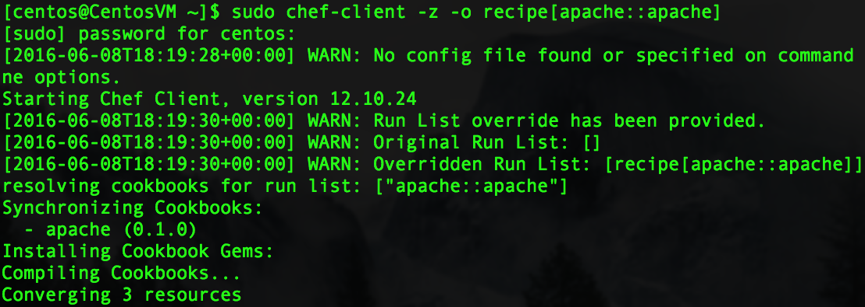
Converge The Node
Notes:
Notes:

Slide 25
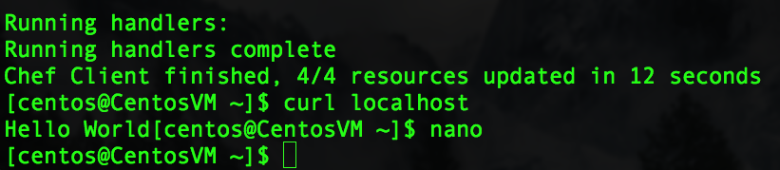
Converge The Node
Note the following:
‘Chef Client finished’ message
Total number of resources updated
Time taken by the run
Notes:
Notes:
The next time this chef-client command is run, since the node is already adhering to the stated policy, you should see “0/4 resources updated…”.
If you were to change something about the node, like manually edit the content of the Hello World file and then rerun chef-client, it would test to see that the contents of the file were correct (which they would not be) and then chef-client would repair the file, setting it back the way it should be with ‘Hello World’ as the content. This is called test and repair. You would then see “1/4 resources updated…” since the file resource was updated.
Why are there 4 resources to update if we only put 3 resources in our recipe? The ‘service’ resource has two actions, enable and start. These count as two, plus the package resource and file resource gives us 4 total resources.
Some windows machines always have at least one resources updated, even if nothing has changed. This is just the nature of how windows resources are tested by chef-client.

Slide 26
Verify Web Server Funtionality
$curl localhost can verify (without being limited by network issues):
the web server has been installed
the httpd service is running
the web page is being served correctly
Notes:
Notes:
Curl is used for CentOS as a command line web browser. Invoke-WebRequest is the equivalent for Windows Powershell.

Slide 27
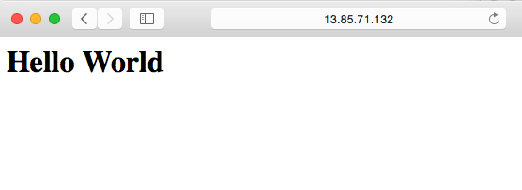
Verify Web Server Functionality
Open the newly created web page
Find the IP Address of the virtual machine
Enter the IP Address into a web browser to see the ‘Hello World’ page displayed

Slide 28
Installing ChefDK On Windows
Find the ChefDK for Windows installation msi
From the Windows VM, open a web browser
Navigate to http://downloads.chef.io/chef-dk
Choose Windows and click the Download button for ‘Windows’
Note: if you do not see the download button, install another browser, such as Firefox
Install the ChefDK msi
Notes:
Notes:
While ChefDK is installed on CentOS using the command line, CHefDK is installed on Windows using a .msi and the Windows package manager.

Slide 29
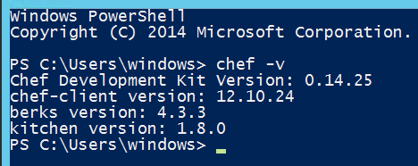
Windows ChefDK Step 2
Verify the ChefDK installation
From a PowerShell window, execute the ‘chef -v’ command PS> chef -v
Reporting of the version numbers indicates a successful installation
Notes:
Notes:
Once installed, most all the ChefDK-related commands are the same between Linux and Windows. However the code written in the recipes will, in most cases, be different.

Slide 30
Write A Chef Web Server Recipe
First, create a cookbooks directory
From within the Powershell Window
From the home directory, create a cookbooks directory PS> mkdir cookbooks
This is where cookbooks will be stored
Notes:
Notes:
The non-Chef commands, like ‘mkdir’ are specific to Powershell (although mkdir exists in both Linux and Powershell).

Slide 31
Write A Chef Recipe
Second, create a new cookbook
From the home directory, use the chef generate command to create the IIS cookbook PS> chef generate cookbook cookbooks/IIS
Notes:
Notes:
The chef generate command creates a basic cookbook structure “chef generate cookbook” is the command to create a cookbook “cookbooks/IIS” is the path and cookbook name

Slide 32
Write A Chef Recipe
In the file, add the resources to enable, configure and start IIS
Start with the resource to enable IIS
powershell_script 'Install IIS' do
code 'Add-WindowsFeature Web-Server’
guard_interpreter :powershell_script
not_if "(Get-WindowsFeature -Name Web-Server).Installed”
action :run
end
Notes:
Notes:
We don’t actually ‘install’ IIS because IIS already exists within Windows. We are really enabling it here.
The “Install IIS” name on the powershell_script line does nothing other then add info to the log output. It is the ‘code’ line that actually installs IIS. This is the same Powershell code you could enter into the Powershell command line. Chef is simply sending this code to the Powershell interpreter on your behalf.
The guard_interpreter and the not_if lines ensure that the install doesn’t run if it is already enabled. This is actually unnecessary in this instance because add-WindowsFeature is already idempotent, but it is good practice to include (especially if add-WindowsFeature ever changes its behavior) as well as it demonstrates how to build idempotence.
The default action is ‘run’. You can actually leave this line out since in Chef resources all default actions can be left out. We add it in here just for clarity.

Slide 33
Write A Chef Recipe
Write a web page for IIS to serve up
Next, use the ‘file’ resource to create a web page
The file name is ‘c:\inetpub\wwwroot\Default.htm’
file ‘c:\inetpub\wwwroot\Default.htm’ do content ‘<html><body><h1>Hello World</h1></body></html>’ action :create end
Notes:
Notes:
The file resources is almost identical between Linux and Windows. The primary difference would be in how the file permissions are defined. Whereas Linux uses: mode “0644” Windows would use: rights :read, “Everyone”
The default action is ‘create’. You can actually leave this line out since in Chef resources all default actions can be left out. We add it in here just for clarity.

Slide 34
Write A Chef Recipe
Start the IIS web service
Use the ‘service’ resource to start IIS (w3svc)
Brackets denote that two separate actions are being implemented
The two actions ‘enable’ the service to start upon reboot as well ‘start’ the service now
service ‘w3svc’ do action [:enable, :start] end
Notes:
Notes:
w3svc is the name of the IIS service
The default action for ‘service’ is ‘nothing’. Here we specify additional actions.

Slide 35
Completed install-iis.rb File
powershell_script 'Install IIS' do
code 'Add-WindowsFeature Web-Server'
guard_interpreter :powershell_script
not_if "(Get-WindowsFeature -Name Web-Server).Installed"
action :run
end
file 'c:\inetpub\wwwroot\Default.htm' do
content '<html><body><h1>Hello World</h1></body></html>'
action :create
end
service 'w3svc' do
action [:enable, :start]
end

Slide 36
Converge The Node
Instruct the node to execute the Chef recipe
From the Powershell command line, in the home directory, invoke chef-client PS> cd ~ PS> chef-client -z -o recipe[IIS::install-iis]
Watch the node install, configure and start the IIS service
Notes:
Notes:
‘cd ~’ means change to the home directory

Slide 37
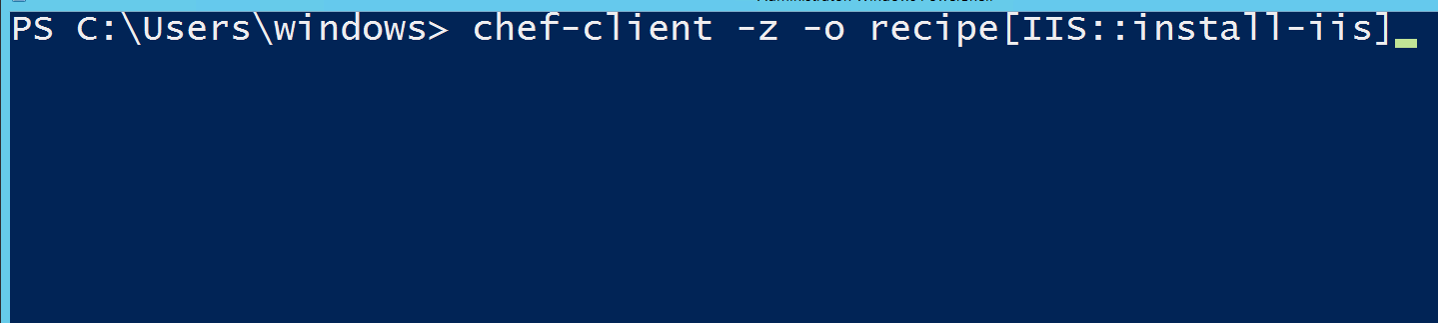
Converge The Node

Slide 38

Converge The Node
Note the following:
‘Chef Client finished’ message
Total number of resources updated
Time taken by the run
Notes:
Notes:
It is very common for Windows servers to take longer then Linux servers for Chef convergance

Slide 39
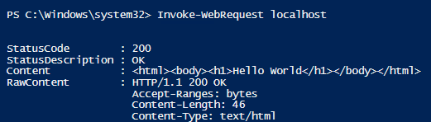
Verify Web Server Funtionality
PS> Invoke-WebRequest localhost can verify (without being limited by network issues):
the web server has been installed
the IIS service is running
the web page is being served correctly (note the 200 response and the correct content being returned)
Notes:
Notes:
A 200 response means a normal web response.
This indicates that the web server is functioning correctly. If you can not reach the web server through a web browser from your *local* computer but you can reach it from a Powershell window on the instance itself, then check to see if the endpoints were set up with port 80 correctly.

Slide 40
Verify Web Server Functionality
Open the newly created web page
Find the IP Address of the virtual machine
Enter the IP Address into a web browser to see the ‘Hello World’ page displayed

Slide 41
Summary
In this lesson, you have learned:
The purpose and functionality of a web server
How to launch a virtual CentOS and Windows instance
How to write a Chef recipe to Install, Start and Configure an Apache and IIS web server
Use of the chef-client command to converge the node
The steps needed to visually ensure that a web server is properly running
Notes:
Notes:
The Module 7 Lesson 4 Lab should be completed at this time
https://github.com/MSFTImagine/computerscience/tree/master/Complimentary%20Course%20Content/Module7/Labs

